Slide 1
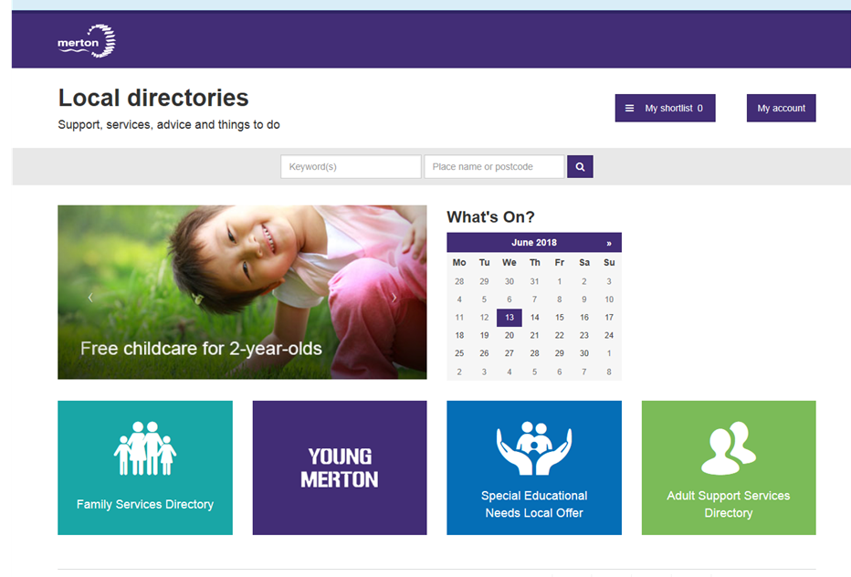
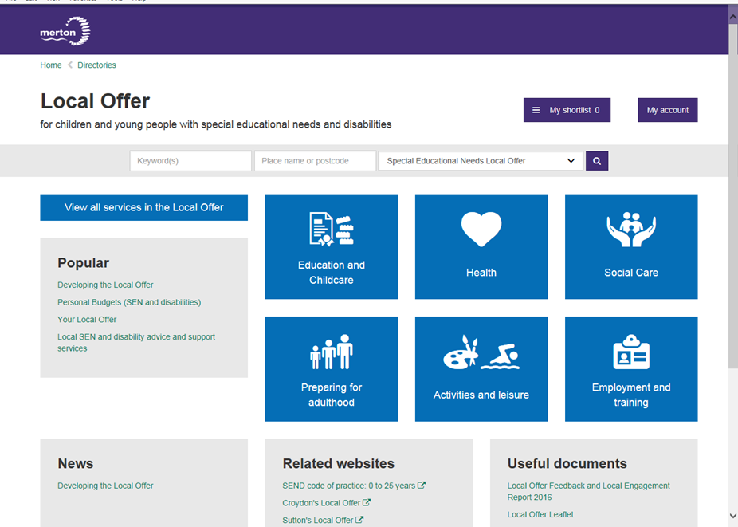
Family Service Directories
www.merton.gov.uk/fsd

Slide 2
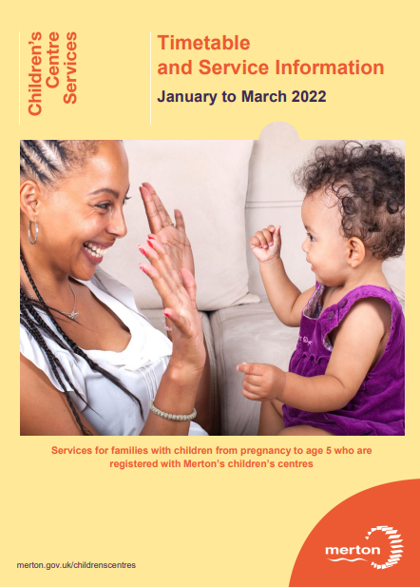
Children’s Centres
Merton has a thriving network of children’s centres with co located health visiting and midwifery service delivery.
Children’s centres offer a range of group programmes, supporting families with children under 5 to understand and best support their child’s development

Slide 3
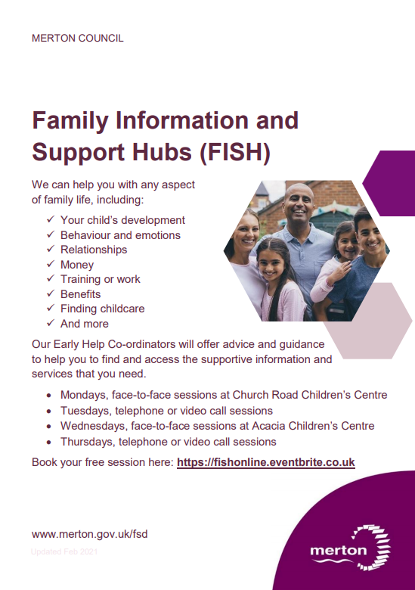
Family Information & Support Hubs (FISH)
FISHs provide an access point for parents/carers (with children of all ages) to gain information, advice and guidance on a range of subjects.
Bookable via Eventbrite
(either by parents/carers or by a practitioner on their behalf)
EVENTBRITE

Slide 4
Family Wellbeing Service
Family Wellbeing Case Work
Service work with families, over a period of 3 – 6 months
Family Wellbeing Service case practitioners will provide the Key Worker/Lead Professional role working directly with family members and coordinating support and information sharing across the professional network.
The Family Wellbeing Case Practitioners work to a whole family approach providing family support where families are experiencing multiple / complex needs
Requests for support via the Children and Families Hub
Group Parenting Programmes
The family Wellbeing Service deliver a range of evidenced based group parenting programmes for the families they support and those working alongside children’s social care
The ‘Triple P’ programmes give parents simple and practical strategies to help them build strong, healthy relationships, confidently manage their children’s behaviour and prevent problems developing. Programmes are available for families with children from 3 – 16, delivered both in person and online
Freedom Programmes are designed to support those effected by domestic abuse, with programmes available for both victims (child and adult) and perpetrators
Requests by professional referral using programme request from

Slide 5
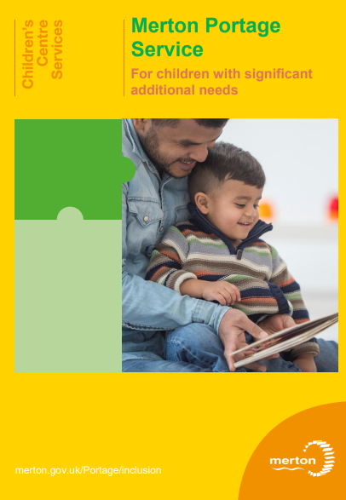
0-5 Family and Parenting Support (SEND)
PORTAGE FAMILY SUPPORT
For children born with complex needs or where complex needs identified before 2nd birthday
Regular home visits to model activities and interventions to support the child’s development
Explanation and modelling of recommendations made by physio, OT and S&LT
Multi-professional working including joint visits and meetings
Referrals to professionals, charities and organisations
Support to apply for DLA
Access to portage support group every week
Support to transition into a pre-school or nursery class once 2 or 3

Slide 6

0-5 Family and Parenting Support (SEND)
FAMILY SUPPORT FOR FAMILIES OF CHILDREN WITH SEND
Children identified as having developmental delay across 2 areas of learning from 21 months plus (and where child is not attending childcare)
Regular home visits to model activities and interventions to support the child’s development
One to one sessions offered within local children centre
Explanation and modelling of recommendations made by professionals
Multi-professional working including joint visits and meetings
Referrals to professionals, charities, housing and other organisations
Support to apply for DLA
Access to a social communication group every week
Support to transition into a pre-school or nursery class once 2 or 3

Slide 7
0-5 Family and Parenting Support (SEND)
PARENTING SUPPORT
Incredible Years ASD.
This 11 week course includes developing strategies to support social communication, play, emotion coaching and ways to manage challenging behaviour.
The course also supports parents with a range of interventions which includes:
Understanding stage 1 of the Attention Autism approach
Understanding their child’s sensory integration difficulties and interventions that will support this
Supporting their child’s communication and language
Using visuals, objects of reference, now/next and choice boards
Putting their child in the ‘spotlight’ by using the Intensive interaction approach

Slide 8
0-5 Family and Parenting Support (SEND)
INCLUSION SUPPORT
within PVI settings, school nursery classes and childminders for children who have a developmental delay or SEND.
Half termly (or termly) visits to observe the child, the interventions in place and assess the child’s needs
Advice for the setting on appropriate interventions and strategies needed to support the child
Modelling interventions and small group work
Support given to make referrals to professionals or chase
Guidance around putting SEN Support in place
Discussion and checking that the child is taking up their education entitlement (EEF)
INSET workshops offered for small staff teams
Advice around accessing additional funding

Slide 9

0-5 Family and Parenting Support (SEND)
TRAINING
for PVI settings, school nursery classes, childminders and children centre staff – around children who have a developmental delay or SEND.
SENCO Training – to understand statutory requirements, code of practice and know how to put SEN Support in place
Autism Awareness
Attention Autism approach
Supporting children with sensory integration difficulties
Supporting children’s behaviour
Supporting children’s communication and language
Using visuals, objects of reference, now/next and choice boards
Sensory stories
Language groups
Intensive interaction

Slide 10

Family Wellbeing Service Parenting Programmes (SEND)
Triple P Stepping Stones
9 week programme for ages 5 – 11 years.
For children with a disability or additional needs.
Understand developmental needs and support emotional and
behavioural development of children and young people

Slide 11
Short Breaks Service (SEND)
Short Breaks
Services (previously called respite care) are fun and /or educational activities for children and young people with disabilities and additional needs. They support disabled children and their families who can't use universal services. They give children and young people a chance to socialise and gain independence while their families get to take time out from caring. Short Breaks Services can be offered during the day, in the evenings, at weekends or during school holidays.
M CARD
Children and young people on Merton's Disability Database may be eligible for an M-Card. This card will identify that your child has a disability or special need and can be used to obtain concessions or get help such as 'fast tracking' when there are long queues.
Children must be registered on the Merton Disability Database before an application for an M-Card can be accepted. Your child must meet certain criteria to be eligible for an M-Card. You can apply to join the database and apply for an M-Card in a single online application.

Slide 12
Your thoughts…

