Slide 1

NAS Parenting Programmes
Notes:
Takes place at cricket green school for Merton families whose child attends a Merton mainstream school. Nominal charge currently £30 to cover book that accompanies course and refreshments. 2.5 sessions in the morning 9.30-12pm. Currently delivered by members of the MAIOS team and the EP service who have all been licemsed to deliver the programme by the NAS.

Slide 2

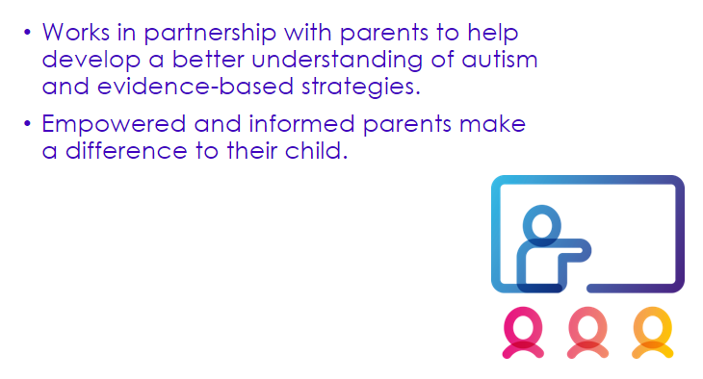
Notes:
The Early Bird programme aims to empower parents by building confidence and developing resilience. Three programmes covers from pre-school up to 16 years of age.
Every session includes discussion and participation parents are encouraged to consider how techniques and strategies discussed could be used with their individual children.

Slide 3

The programme is aimed at families whose child is under 4 years.
Two places are offered to each family attending.
Eight group sessions and a small number of home visits over a three month period to a maximum of 6 families.
Notes:
The NAS delivered its first EarlyBird programme in 1997 to support pre-school children.

Slide 4


Session 1. Understanding Autism
Session 2. Understanding and supporting sensory differences
Session 3. Communication
Session 4. Supporting and developing interaction.
Session 5. Understanding and developing play
Session 6. Understanding and interpreting behaviour
Session 7. Supporting behaviour
Session 8. Moving forward

Slide 5
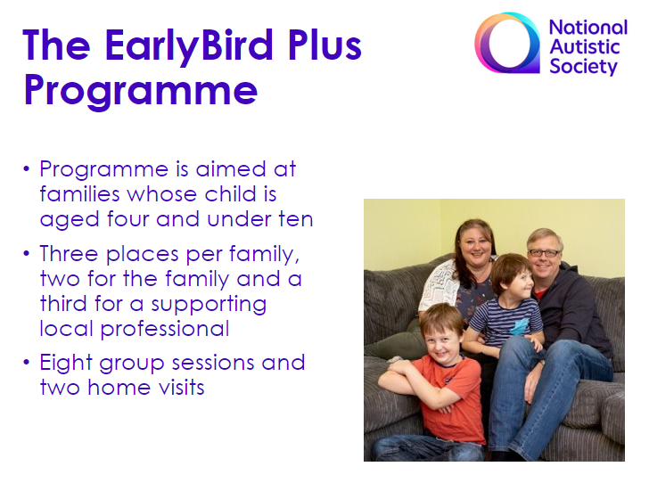

Notes:
The earlyBird plus programme was developed in 2003 to support those diagnosed later to provide a programme for families of young school aged children -4-9.
Maximum 6 families. Professionals from schools also invited.

Slide 6
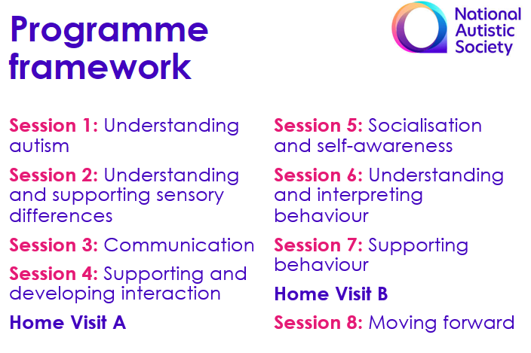


Slide 7

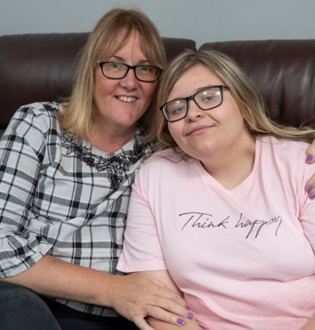
The Teenlife Programme
Aimed at families of autistic young people aged 10 -16 years.
Every family offered two places and can opt to invite a supporting professional to attend the sessions with them.
The Teenlife programme consists of 6 sessions there are no home visits.
Notes:
2017 teenlife programme was produced. Supports between 4 and 6 families.

Slide 8
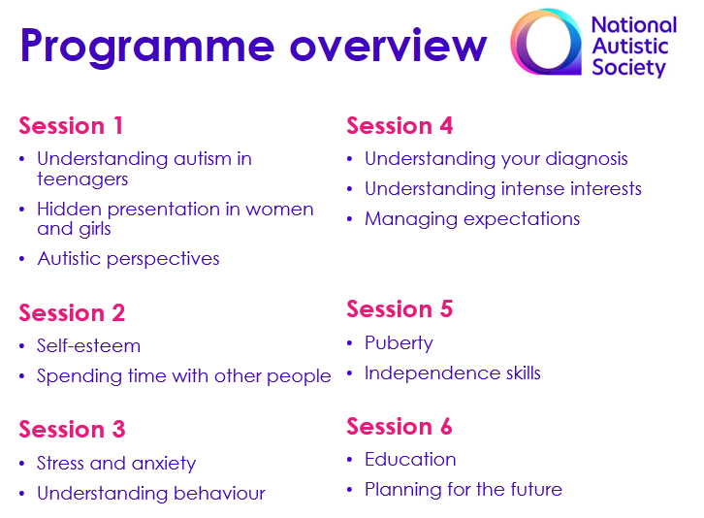


Slide 9
I found the course very useful. Discussing actual events that happened during the week was very useful. Getting views and advice has been very valuable.
EarlyBird Parent
The course was amazing and we have now got a what's app group with the other parents so we continue to learn from each other and remind each other the tools we learnt to help us deal with triggers and problems we may face. Very happy I took part in this.
EarlyBird Plus Parent
Brilliant, well delivered, informative course. I completed the Earlybird Course and this is another great resource for parents too.
Teenlife Parent

Slide 10
How to apply
All parents must self-refer by calling 020 8640 1177 and asking for the EarlyBird Team.
Once a completed application form is received the family is added to the waiting list.
Once a place on a programme becomes available the team will contact you.

Slide 11


Slide 12
Thank you for Listening.
Audrey Moriarty
020 8640 1177

